Slide 1

Behavioral culture of young people in cyberspace

Slide 2
TEAM: FLAMES
1. Nguyen Dinh Thanh(Team Leader)
2. Nguyen Gia Hao
3. Nguyen Thanh Tien
4. Nguyen Hoang Anh Tuan
5. Nguyen Ngoc Bao
6. Le Vinh Hung
7. Nguyen Minh Phuc

Slide 3
INTRODUCTION
REALITY
REASON
CONSEQUENCE
SOLUTION
CONCLUTION

Slide 4
I. INTRODUCTION

Slide 5
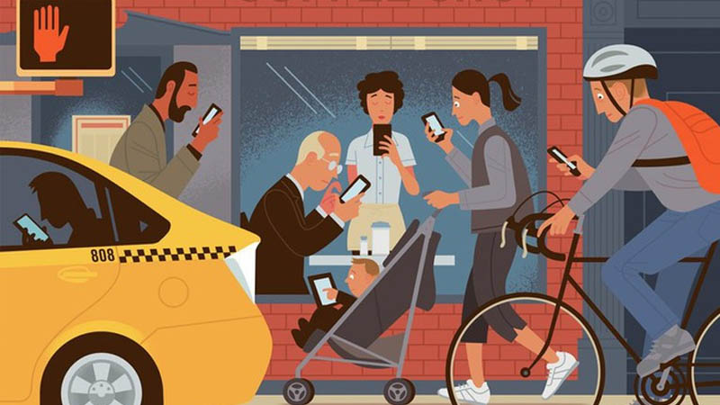
1.1) Introduction to social networks
A social network can be understood as a website or online platform with many different formats and features.

Slide 6

1.2) Features of social networks

Slide 7

1.3) Explain about behavioral culture
Behavioral culture is a way of behaving, communicating, conversing and exchanging with each other by very everyday actions.

Slide 8

1.4) Why we chose this project
Technology 4.0 is becoming more and more popular.
People use social networks, especially young people more and more.

Slide 9
II. REALITY

Slide 10


2.1) Summary of positive situation
Social networks have a very important role in greatly influencing the behavioral orientation.
And behavioral culture of young people.

Slide 11
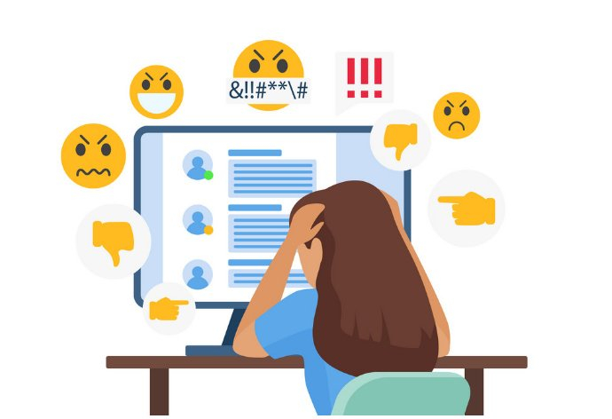
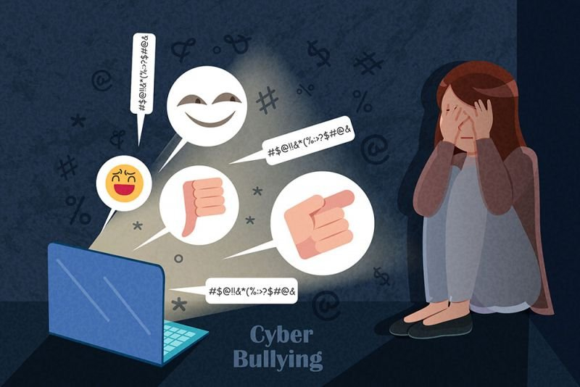
2.2) The reality of negative behavior of young people on social networks
Many cases of unethical behavior on social networks such as: abusive comments, disrespect for others.

Slide 12
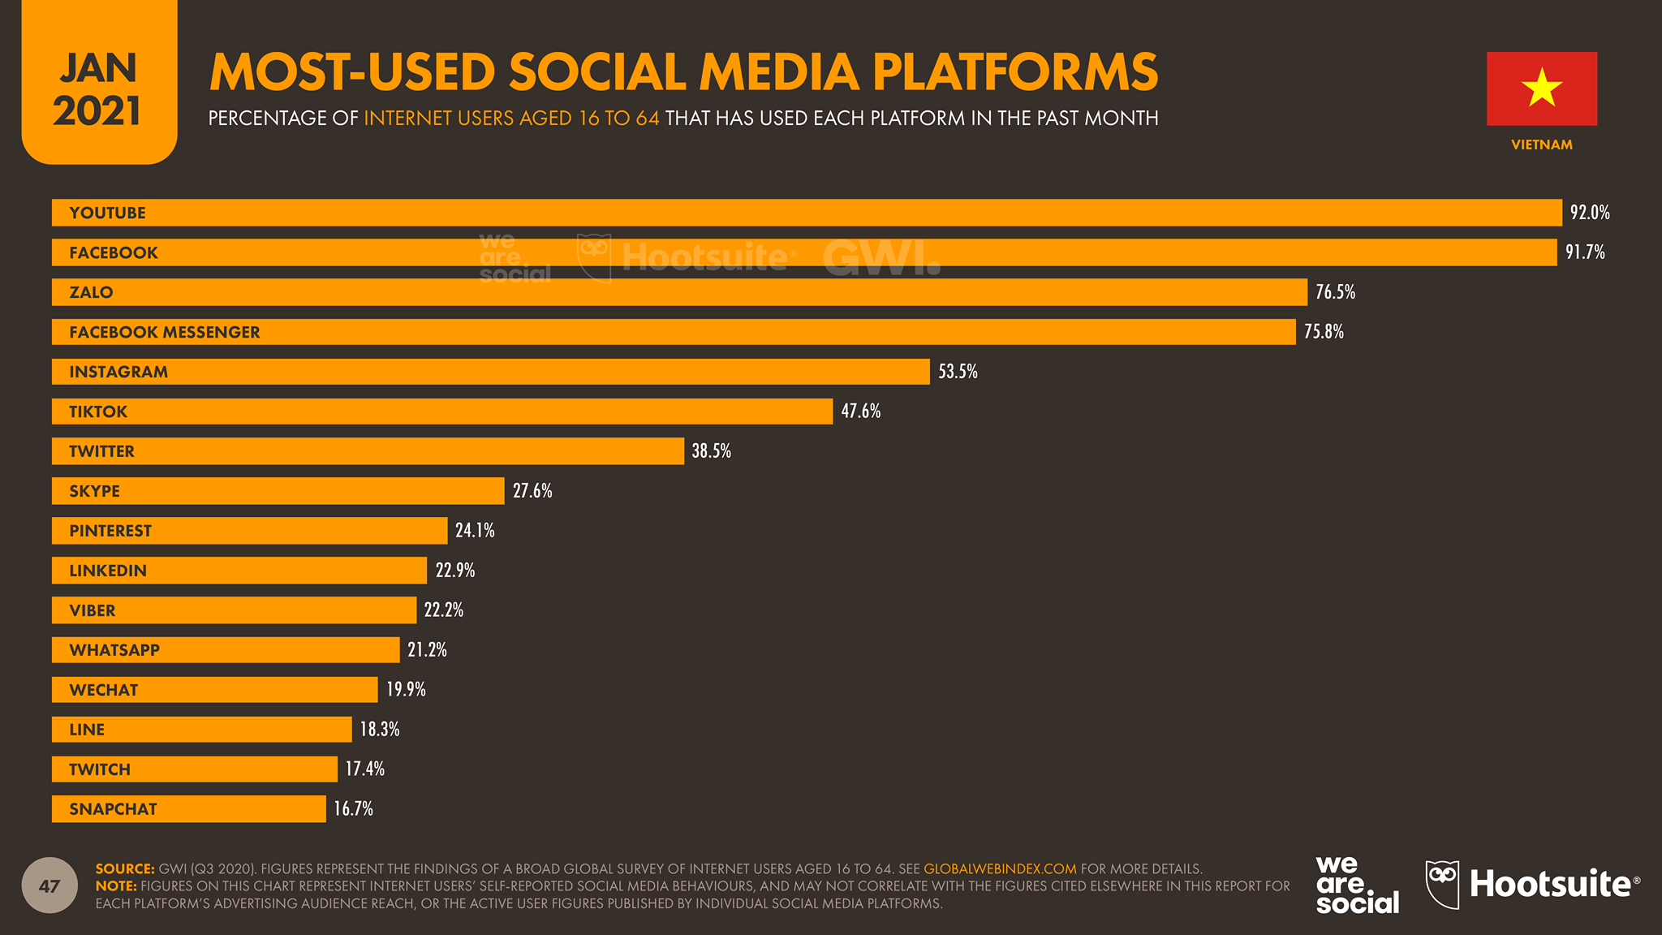
2.3) Ages often have negative

Slide 13
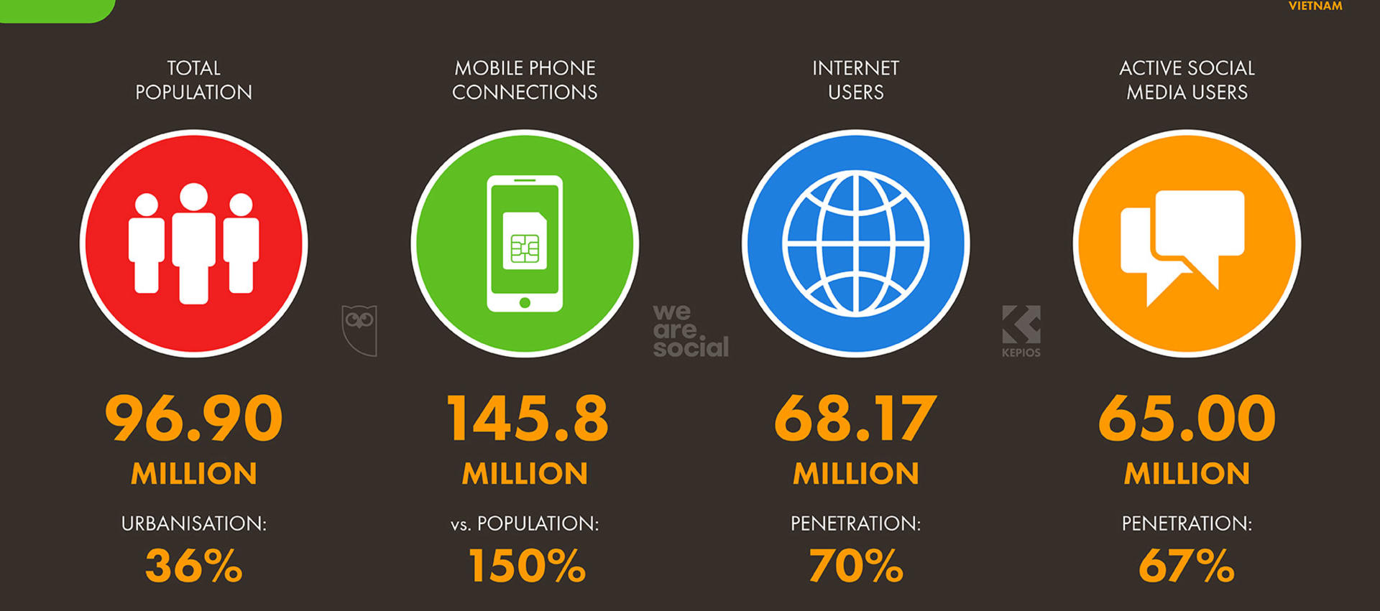
2.3) Ages often have negative

Slide 14
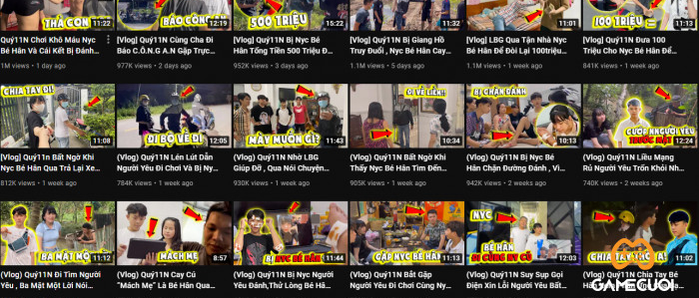
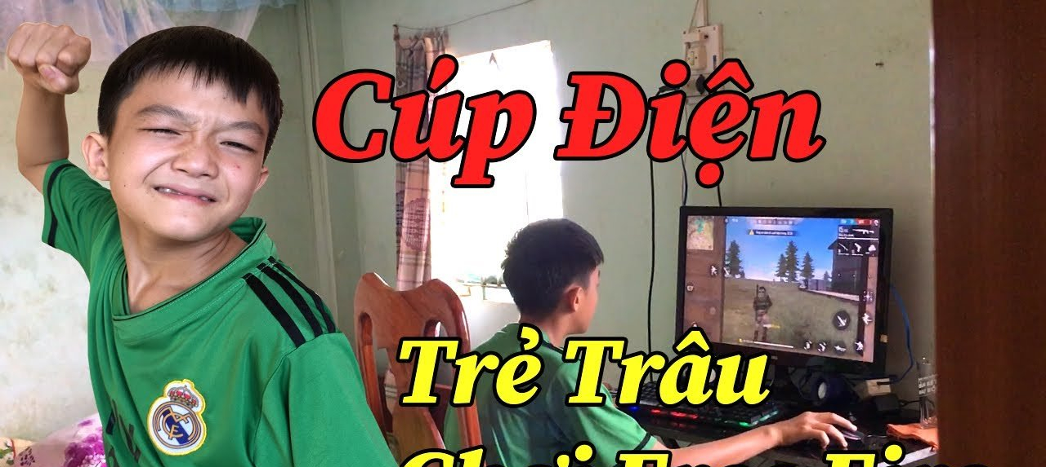
2.4) Give specific examples of negative situations

Slide 15
III. REASON

Slide 16
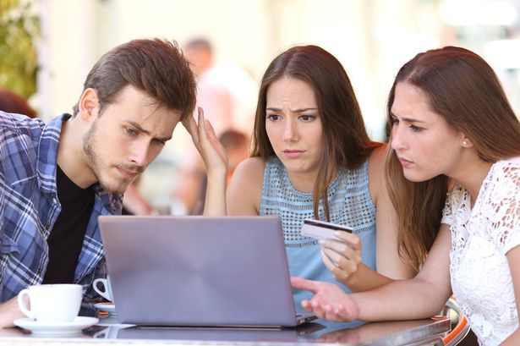
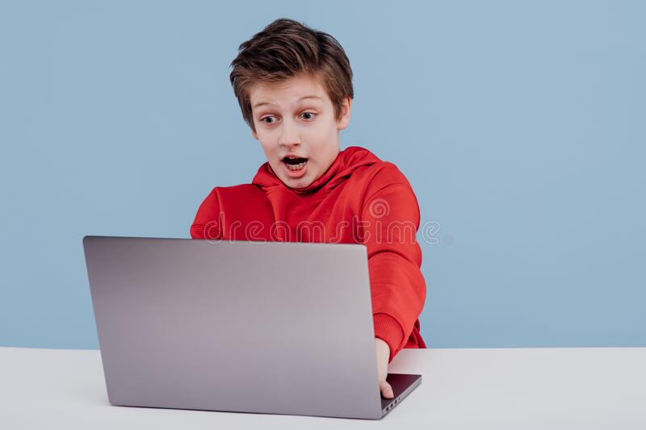
3.1) Subjective reasons
First be mentioned that people's sense of using social networks is not good.
Young people want to prove themselves to everyone, want to be noticed.

Slide 17
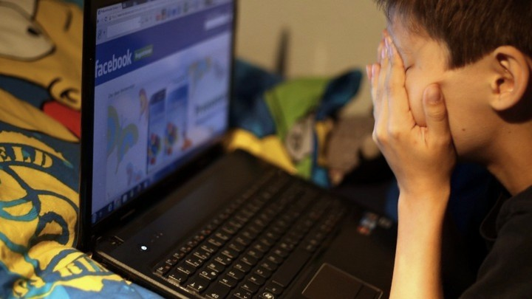
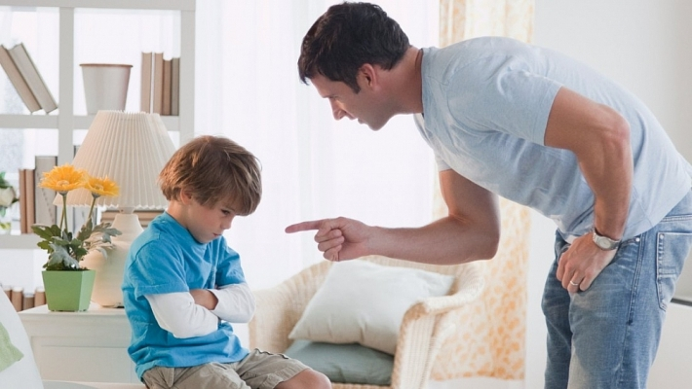
3.2) Objective reasons

Slide 18
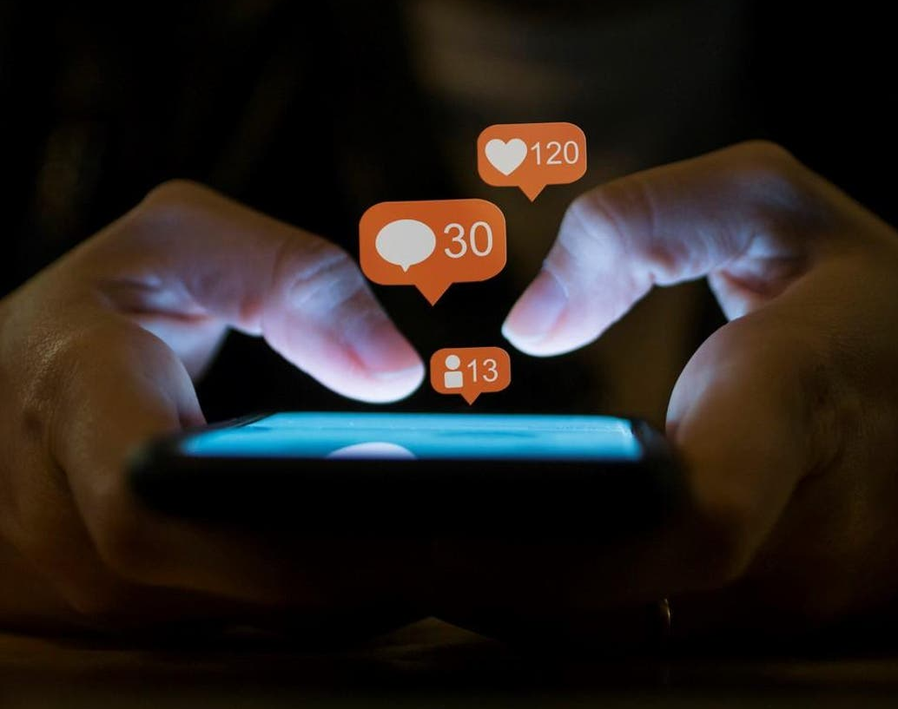
IV. CONSEQUENCE

Slide 19

4.1) Impact with themselves
A) Designed to encourage users to overuse:

Slide 20
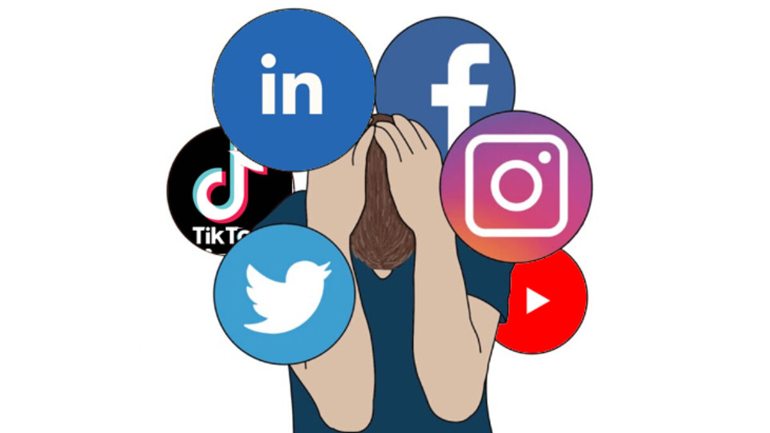
B) Increased feeling of loneliness
The emotion aroused by a "like" can temporarily relieve loneliness.

Slide 21
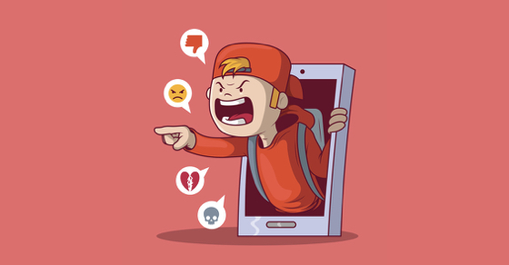
C) Online Bullying
Friends on social media easily make children feel more confident.

Slide 22

4.2) Impact with people and society
Social media has a negative impact on cultural development.
Social media is becoming a tool, a "fertile" environment for criminals to exploit.

Slide 23

V. SOLUTION

Slide 24

5.1) Suggest possible solutions that help people fix

Slide 25
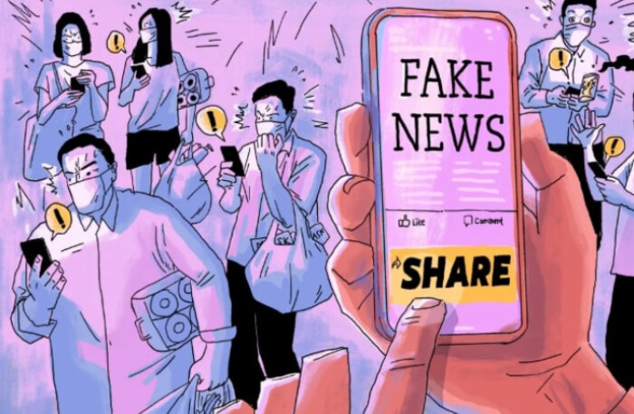
5.2) Give some videos to convince people

Slide 26

5.3 What are the benefits that videos bring to viewers?

Slide 27

5.4) Why should we follow?

Slide 28

VI. CONCLUSION

Slide 29


6.1) Advice for everyone
Let’s use social networks in a reasonable and timely manner, avoiding falling into the state of “social networks addiction”.

Slide 30

6.2) Practical sense of the project's benefits
To improve communication skills, cultural behavior on social networks for the young generation.

Slide 31


Slide 32
THANKS FOR WATCHING

